Slide 1
Smartphone-based Fall Detection
Ariel Keller
7/27/2012

Slide 2
1. Introduction
Falls are:
The leading cause of hospitalization of elderly [3].
The sixth cause of death for those over 65 [3].

Slide 3
1. Introduction
As current population ages, we expect to soon have a higher percentage of elderly population than ever before [6].

Slide 4
1. Introduction
Falls and fall detection are of immediate importance.

Slide 5

2. Definition
Acceleration magnitude is measured by a “root-sum-of-squares” (RSS) value…
RSS =
RSS values are often expressed in gs
g is acceleration due to gravity, i.e. 9.8 m/s²

Slide 6
2. Definition
What is the “anatomy” of a fall? [3]
Free fall
RSS value falls below 1g, approaching 0g.
Impact
On impact, the RSS value spikes, usu. to above 3g.
Inactivity

Slide 7
3. Evaluation
True positive (TP): a fall occurs and is correctly detected.
False negative (FN): a fall occurs and is not detected.
False positive (FP): a fall did not occur, but the system detected a fall.
True negative (TN): a fall did not occur, and the system did not detect a fall.

Slide 8
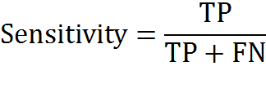
3. Evaluation
Sensitivity is the system’s ability to detect real falls.
Equation 1.1

Slide 9
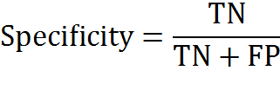
3. Evaluation
Specificity is the system’s ability to detect only real falls, in other words, its ability to filter out false positives.
Equation 1.2

Slide 10
4. Motivations
High demand
Problems with current systems
Many false positives & thus poor specificity

Slide 11
5. Related Work
Thresholds—a common fall detection approach. [2]
Lower fall threshold (LFT)
Typically somewhere between 0g and 1g.
Upper fall threshold (UFT)
Usually set at or above 3g.

Slide 12
5. Related Work
Detecting a fall using thresholds:
RSS drops below LFT (Free fall)
RSS spikes above UFT (Impact)
Check for inactivity
Used by some systems, like [1]. It helps decrease false positives.

Slide 13
5. Related Work
Using gyroscopes for posture information [3].
Gyroscopes use more energy than accelerometers [3].

Slide 14
5. Related Work
Abbate et al. [2] proposed a unique approach for decreasing false positives…
Some ADLs (activities of daily living) exhibit peaks similar to falls.
Under the threshold technique, these ADLs are likely to register false positives.

Slide 15
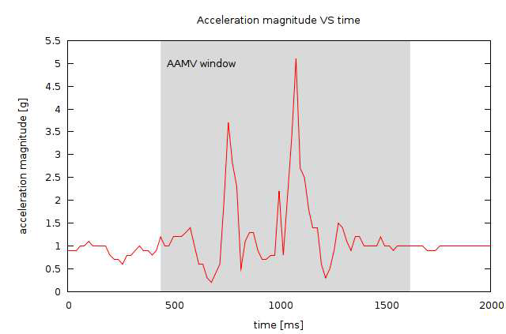
5. Related Work
Real fall:
Image 3.1 From [2].

Slide 16
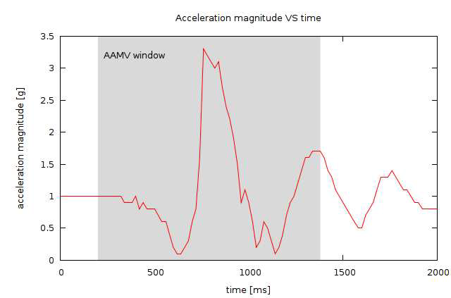
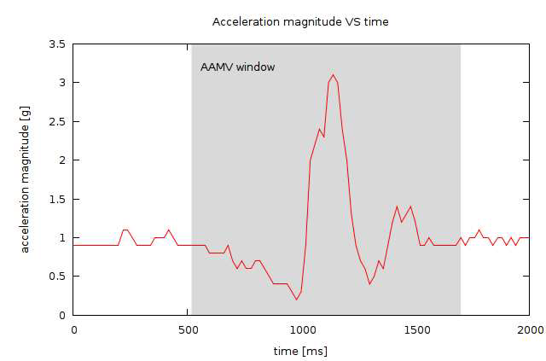
5. Related Work
Class A ADL: Class A ADL:
(Elastic surface) (Soft surface)
Image 3.1 From [2].

Slide 17
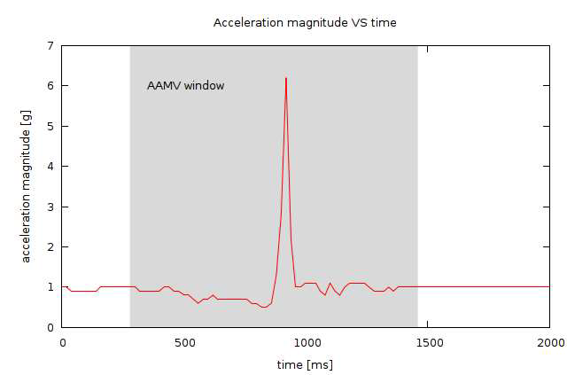
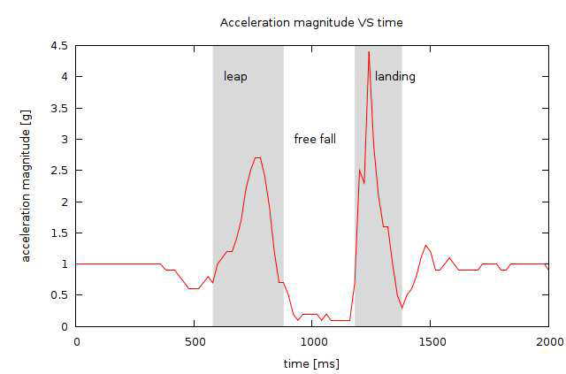
5. Related Work
Class B ADL: Class C ADL:
(Medium/hard surface) (Jumping)
Image 3.1 From [2].

Slide 18
5. Related Work
Abbate et al. defined algorithms to filter out class A, B and C ADLs
Average Acceleration Magnitude Variation (AAMV)
Free Fall Interval (FFI)
Free Fall Average Acceleration Magnitude (FFAAM)

Slide 19

5. Related Work
Equation 3.1 From [2].
AAMV should be higher for real falls than for class A and B ADLs

Slide 20

5. Related Work
Equation 3.2 From [2].
Class C ADLs have a longer FFI and smaller FFAAM than do real falls.

Slide 21
6. Methodology
Our initial algorithm [1]:
Basic threshold approach
Check for inactivity
Too many false positives.

Slide 22
6. Methodology
Chose to implement the algorithms from [2] to filter out fall-like ADLs
Goal
Improved specificity
Comparable sensitivity

Slide 23
6. Methodology
Device: mobile phone
Ubiquitous
Rather inexpensive
Easy to “wear”
Equipped to call for help
Platform: Android
Open source
Written in Java

Slide 24
6. Methodology
The app was originally designed using source code from Gonzales [1]
How the app works:
Enter app
Press “Start Monitoring” button
May leave app and continue to use phone
Service may be explicitly stopped by user

Slide 25
6. Methodology
Service uses an event listener to call onSensorChanged() method when a change in acceleration is detected.
Sampling rate determines how frequently we take accelerometer readings.

Slide 26
6. Methodology
The Android API offers 4 different sampling rates:
NORMAL – 200ms, or 5 Hz
UI – 60 ms, or 16 2/3 Hz
GAME – 20 ms, or 50 Hz
FASTEST – 10 ms, or 100 Hz

Slide 27
6. Methodology
There was too much noise with the GAME sampling rate.
The NORMAL sampling rate was so slow that it missed some peaks and troughs of activities and falls.
The UI sampling rate performed the best.
Not surprising since body movements have a frequency measured below 20Hz [8] and UI is the rate closest to this.

Slide 28
6. Methodology
However, with a slower rate, the readings are farther apart.
This yields a greater variation from one point to the next than with a faster sampling rate.
Class A/B ADLs weren’t filtered properly—the AAMV was too high.

Slide 29
6. Methodology
Implemented linear interpolation to produce a point between any two neighboring points.
Keeps the smoothness of the 60ms rate.
Solves the issue with class A/B filtering.
x = x0 + ½(x1 – x0)
y = y0 + ½(y1 – y0)
z = z0 + ½(z1 – z0)

Slide 30
7. Testing
Tested the following ADLs:
bending, bending-pick-up, jogging, jumping, lying-bed, rising-bed, sit-bed, sit-chair, sit-sofa, sit-air, squatting-down, walking, and walking backwards
All ADLs except jogging and one instance of sit-bed were consistently filtered out.
Specificity = 94.2 %

Slide 31
7. Testing
Figure 5-Jogging with a gradual stop
Figure 6-Jogging with an abrupt stop.

Slide 32
7. Testing
Most of the falls were tested with a dummy.
The dummy is 6’1” and 180 lbs.
It was designed to have the height and weight of an average adult male.

Slide 33
7. Testing
We tested the following falls:
Falling backwards, falling forwards, falling to the left, falling to the right, rolling out of bed.
Note that falling to the left/right & rolling out of bed were tested on a human volunteer.

Slide 34
7. Testing
Very few of fall tests that ended in direct impact to the phone were detected.
Gonzales et al noted having some similar issues with one of the phones they used for testing in [1].
They suggested their phone may have had some internal flaw that caused it not to respond properly when there was direct impact to it.

Slide 35
7. Testing
Clearly, this issue had a significant impact on our system’s sensitivity.
Overall sensitivity was 64.2%.
Sensitivity excluding tests that involved direct impact to the phone was 92.2%.

Slide 36
8. Conclusion/Future Work
Our tests were admittedly limited, with one volunteer testing ADLs and one volunteer and a dummy for testing falls.
Still, our results indicate that using a smartphone for fall detection could potentially be feasible and promising.
Also, that it is possible to detect falls with rather high sensitivity and specificity using only the acceleration magnitude.

Slide 37
8. Conclusion/Future Work
More research is necessary to determine the extent of the issue that some phones have with direct impact.
How common is it?
Is it specific to particular phones/models?
More testing.

Slide 38
References
[1] I. J. D. Gonzales. Fall detection using a smartphone. Master’s thesis, Gjovik University College, 2010-2011. Available in http://www.stud.hig.no/~090285/falldetection.pdf
[2] S. Abbate, M. Avventui, G. Cola, P. Corsini, J. Light, and A. Vecchio. Recognition of False Alarms in Fall Detection Systems. CCNC, IEEE, Italy, 2011, p. 23-28.
[3] S. Abbate, M. Avventui, P. Corsini, J. Light, and A. Vecchio. Monitoring of Human Movement for Fall Detection and Activities Recognition in Elderly Care Using Wireless sensor Network : a Survey, Wireless Sensor Networks: Application-Centric Design, Merrett, G. V., Tan & Y.K., 2010, p. 1-20.
[4] Bagalà F, Becker C, Cappello A, Chiari L, Aminian K, et al. (2012) Evaluation of Accelerometer-Based Fall Detection Algorithms on Real-World Falls. PLoS ONE 7(5): e37062. doi:10.1371/journal.pone.0037062

Slide 39
References
[5] A.K. Bourke, P. van de Ven, M. Gamble, R. O’Connor, K. Murphy, E. Bogan, E. McQuade, P. Finucane, G. ÓLaighin, J. Nelson. Evaluation of waist-mounted tri-axial accelerometer based fall-detection algorithms during scripted and continuous unscripted activities. Journal of Biomechanics - 16 November 2010 (Vol. 43, Issue 15, Pages 3051-3057, DOI: 10.1016/j.jbiomech.2010.07.005)
[6] B. Brown. An Acceleration Based Fall Detector: Development, Experimentation, and Analysis. Summer Undergraduate Program in Engineering Research at Berkeley (SUPERB), University of California, Berkeley, 2005. http://www.eecs.berkeley.edu/~eklund/projects/Reports/GarrettFinalPaper.pdf
[7] Gazmend Bajrami. Activity Identification for Gait Recognition Using Mobile Devices. Master’s thesis, Gjovik University College, 2011.

Slide 40
References
[8] D.M. Karantonis, M.R. Narayanan, M. Mathie, N.H. Lovell, B.G. Celler. Implementation of Real-Time Human Movement ClassifierUsing a Triaxial Accelerometer for Ambulatory Monitoring. IEEE Trans Inf Technol Biomed, 2006, pp. 10:156-167.

